Slide 1
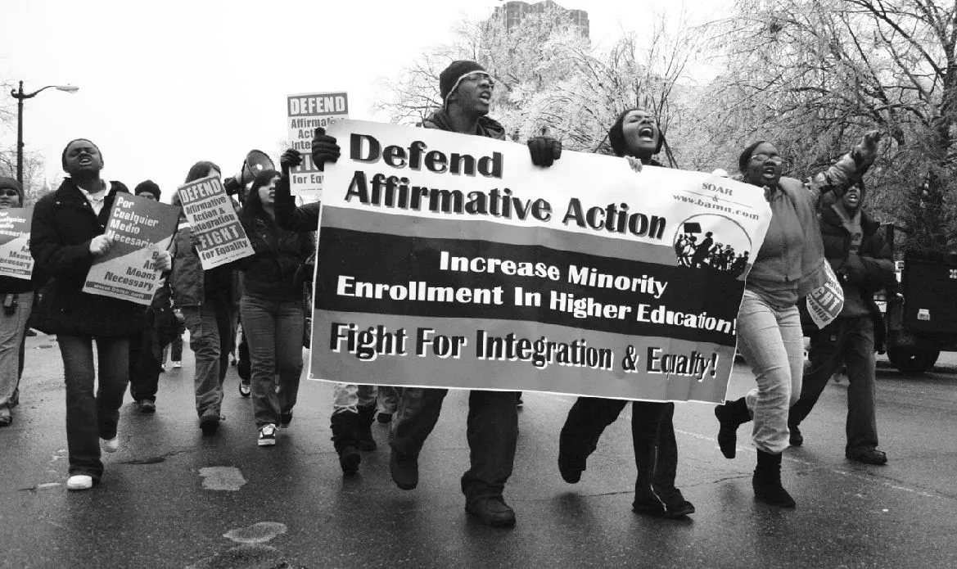
Affirmative Action
RaceFiles
by Aadi Shah, Jacob Horne, Joel Mathew, Pranav Golla

Slide 2
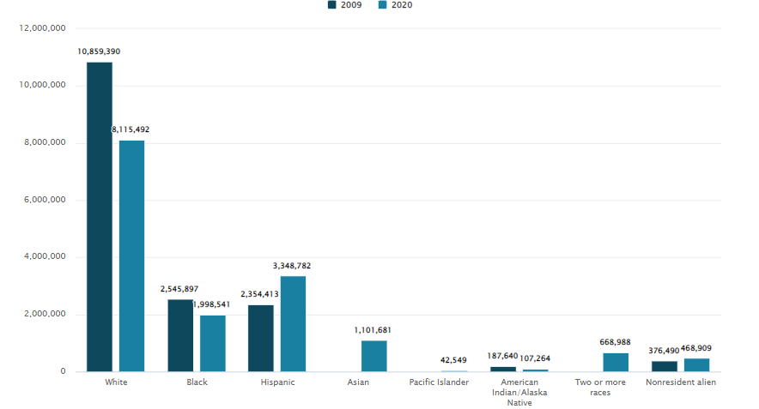
Undergraduate enrollment in degree-granting postsecondary institutions, by race/ethnicity and nonresident alien status: Fall 2009 and Fall 2020
BestColleges

Slide 3
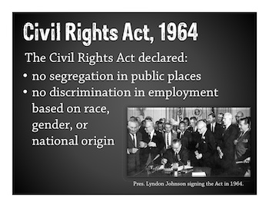
Definition
Affirmative Action as: “the use of policies, legislation, programs, and procedures to improve the educational or employment opportunities of members of certain demographic groups (such as minority groups, women, and older people) as a remedy to the effects of long-standing discrimination against such groups” (Merriam-Webster).
African American Registry
Notes:
Jacob

Slide 4
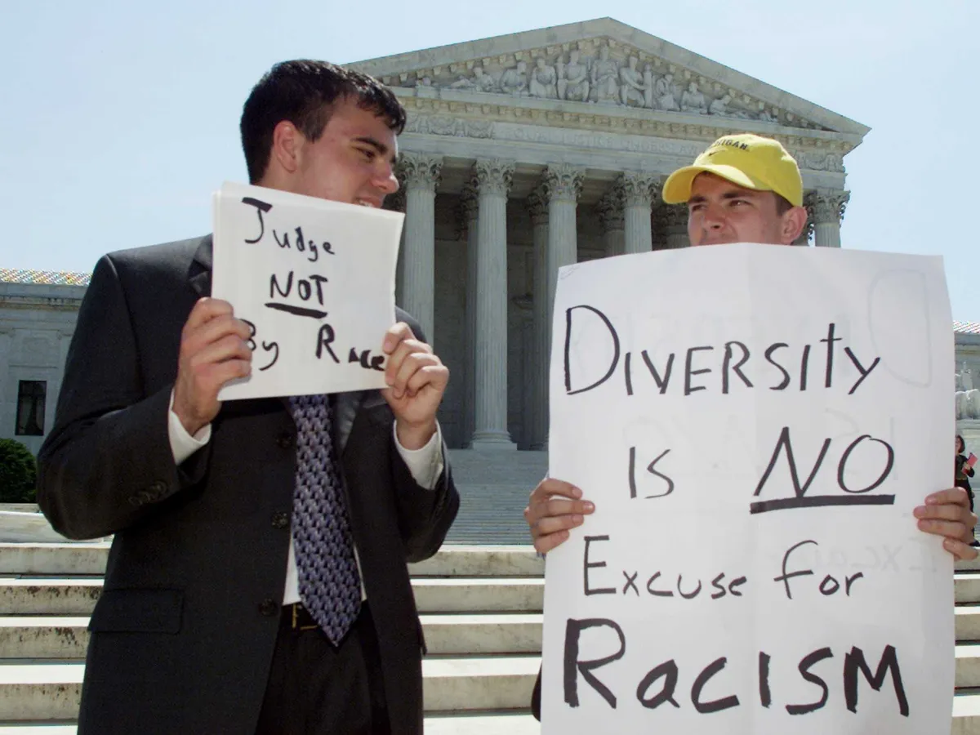
Affirmative-Action based Discrimination
Detrimental to the majority
Employee discrimination
Lawsuits against corporations
The Atlantic

Slide 5


DIYCollegeRankings
Bloximages
Notes:
https://bloximages.newyork1.vip.townnews.com/jackcentral.org/content/tncms/assets/v3/editorial/7/53/75330f3c-195b-11eb-a75f-c7e4fe5f5a64/5f99d37064b01.image.jpg?resize=400%2C296
https://www.diycollegerankings.com/wp-content/uploads/2014/01/Colleges-for-Asian-Students-fb.jpg

Slide 6
To what extent does affirmative action affect the professional opportunity of statistically overrepresented minority groups?

Slide 7
Political and Historical Significance
01

Slide 8
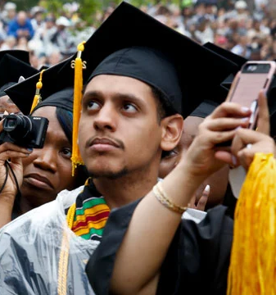
Historical Significance
Affirmative Action intended to increase ethnic diversity
Universities used it to limit the number of overrepresented minorities instead
Similarly, overrepresented minorities are hindered at the executive level of companies
Notes:
aadi

Slide 9
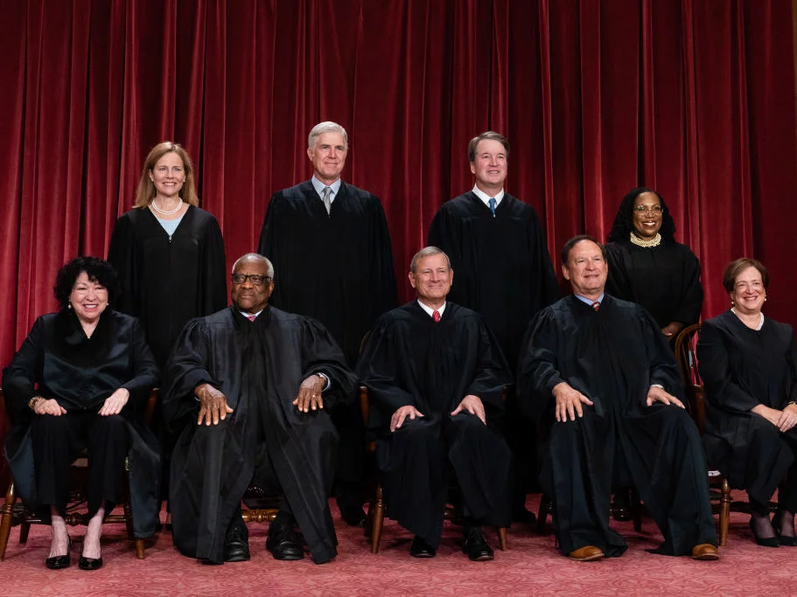
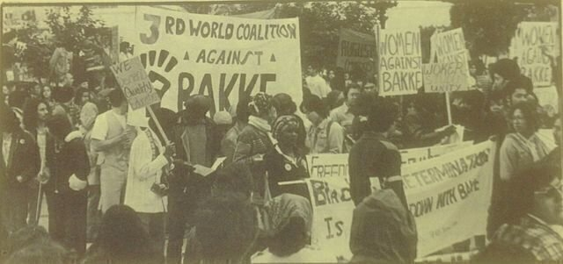
Political Unrest
9 states have banned affirmative action
Current opposition against affirmative action is growing stronger
Notes:
aadi

Slide 10
Ethical
Concerns
02

Slide 11
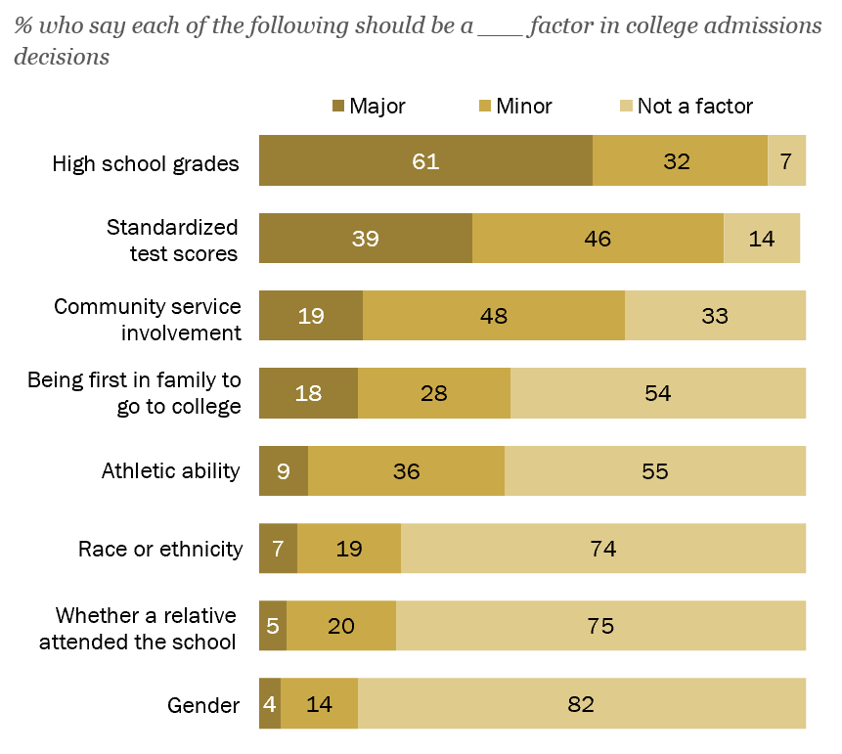
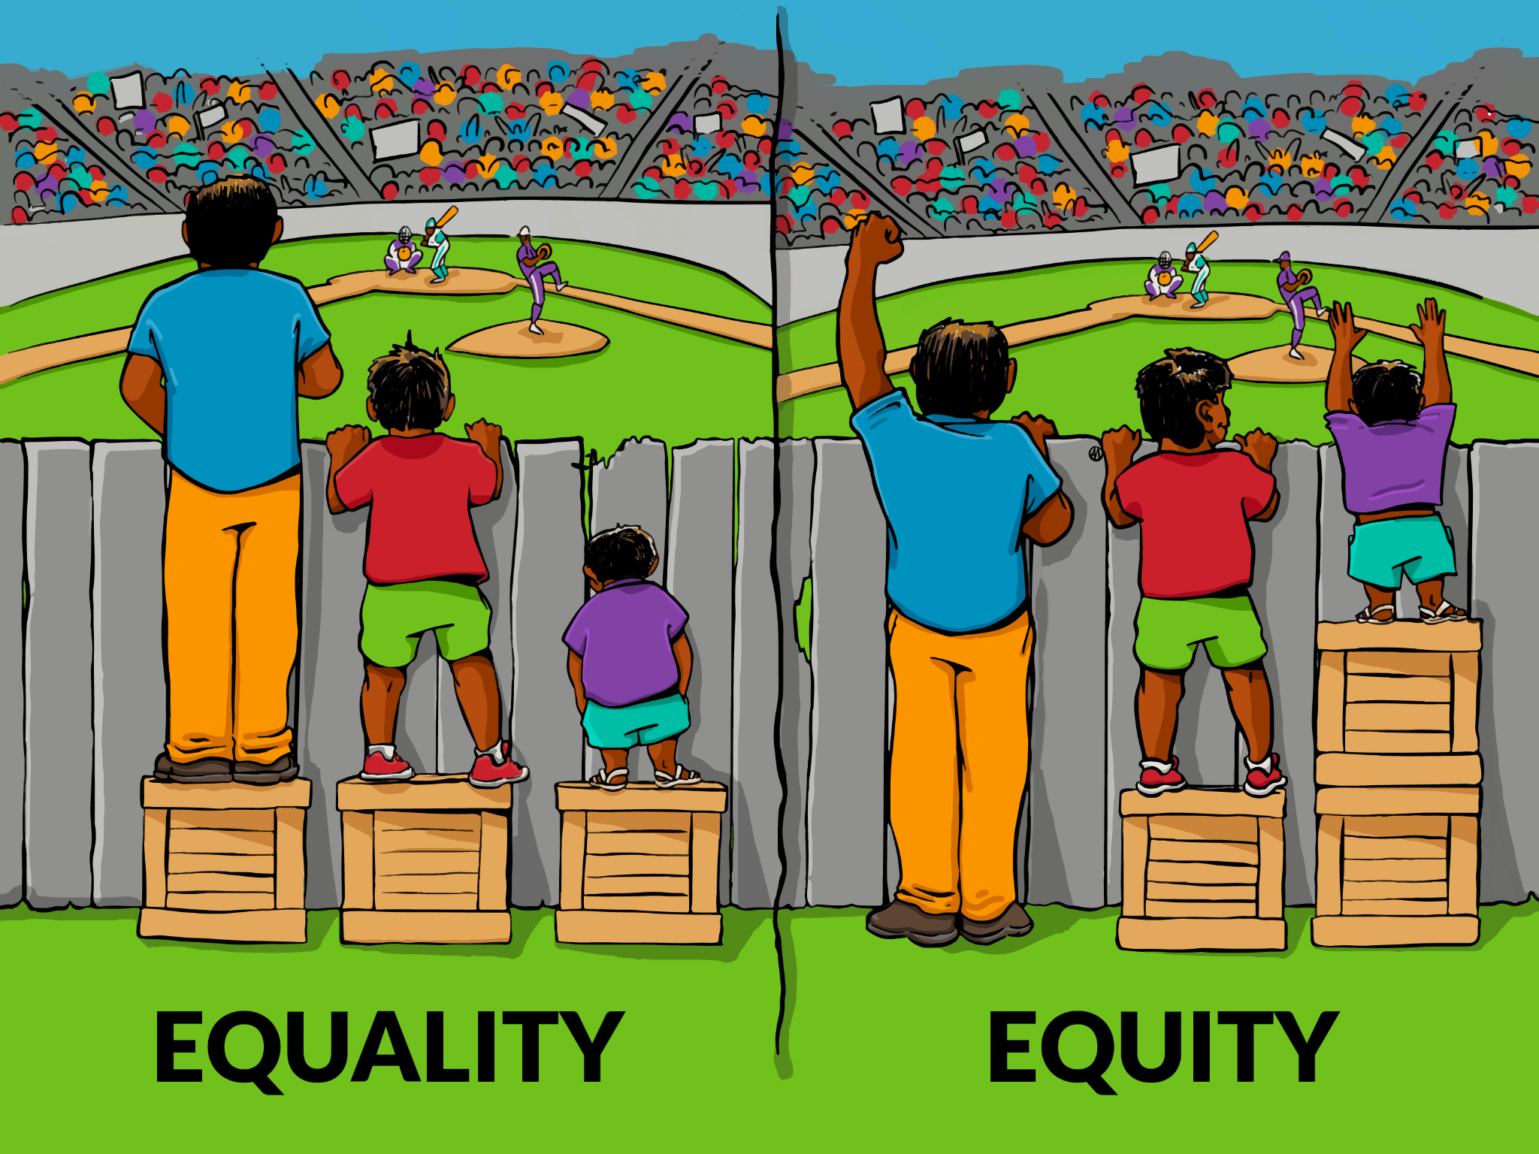
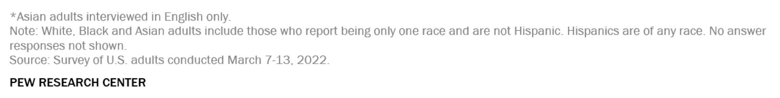
ETHICAL LENS

Slide 12
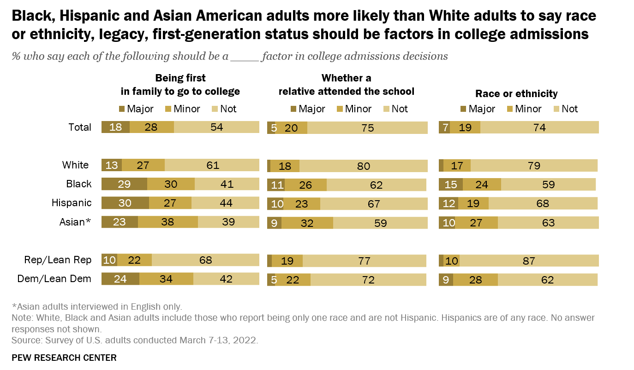
Data & Research

Slide 13
Social
Implications
03

Slide 14
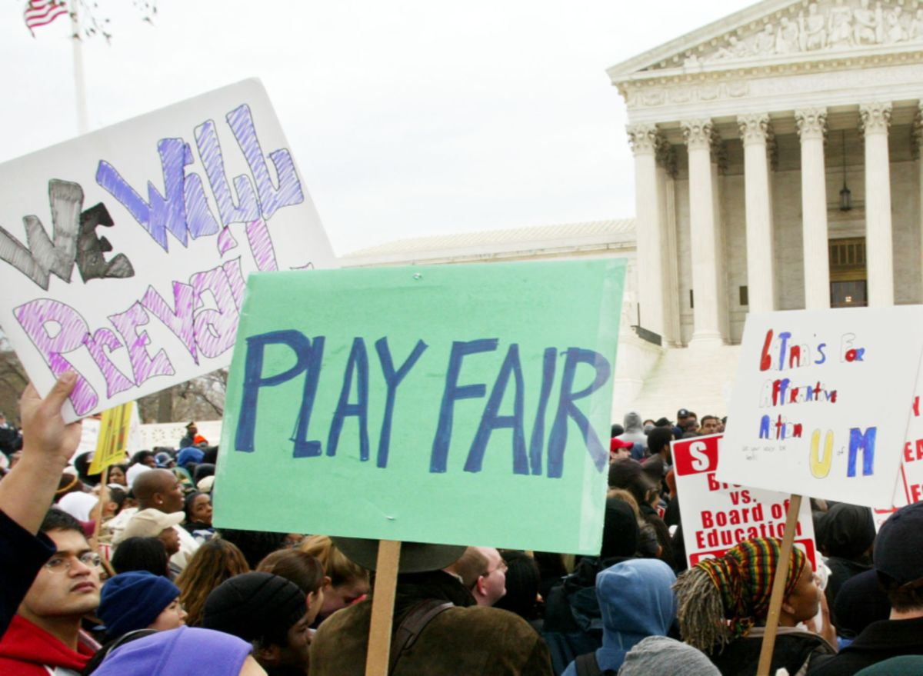
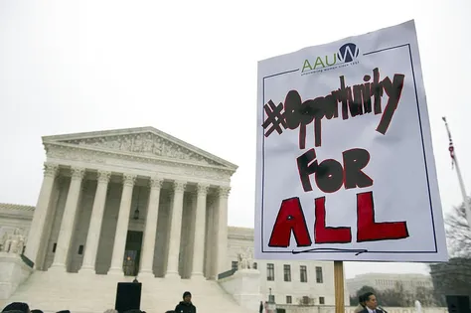
Ethnicity-Based Admissions
BWBX.io
ArkansasOnline
Notes:
Supreme court cases
https://assets.bwbx.io/images/users/iqjWHBFdfxIU/iIyhX7NhHHoA/v1/1200x-1.png
https://www.arkansasonline.com/news/2023/feb/24/amendment-proposed-for-bill-ending-affirmative/

Slide 15
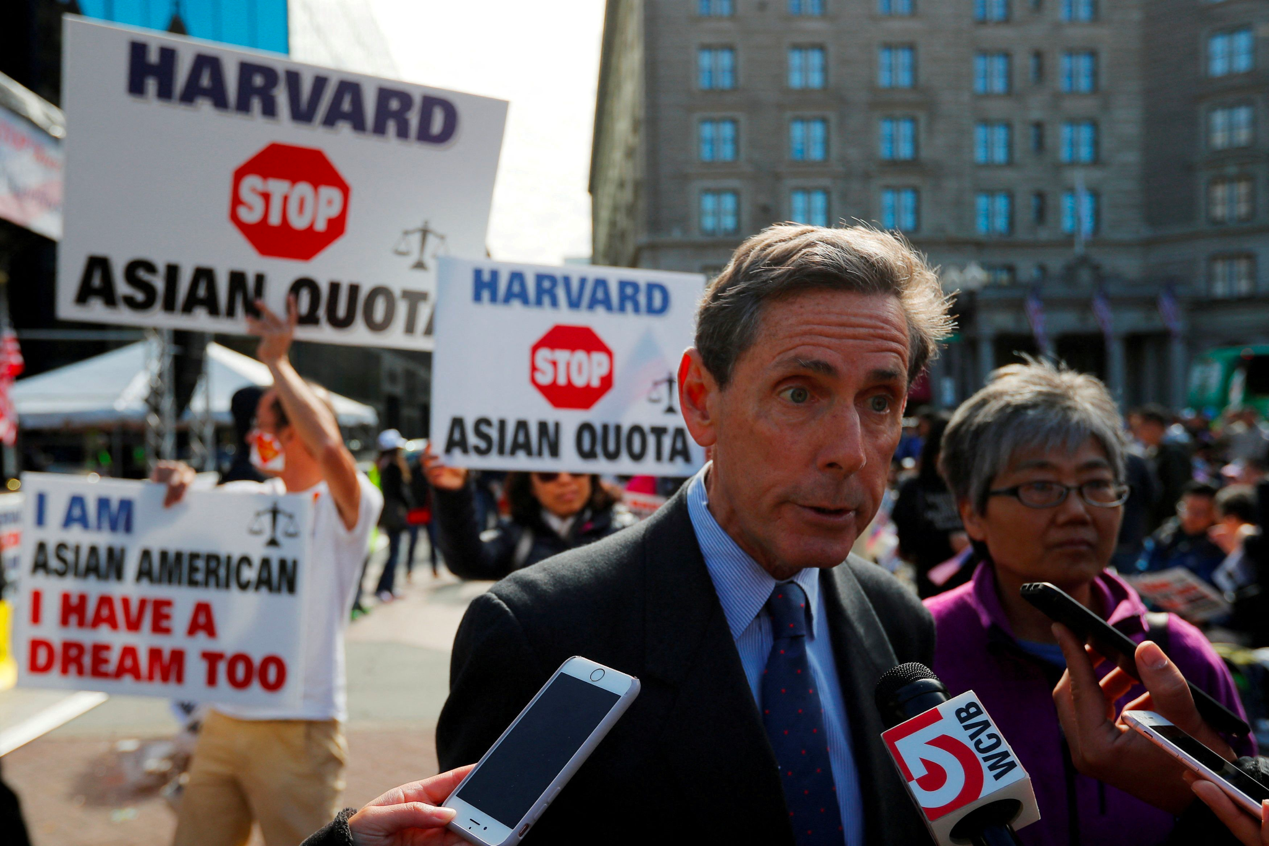
Asian American Discrimination
No evidence against the poor
ratings of Asian applicants
Asian Americans missed
opportunities
Al Jazeera

Slide 16
Economic
Limitations
04

Slide 17
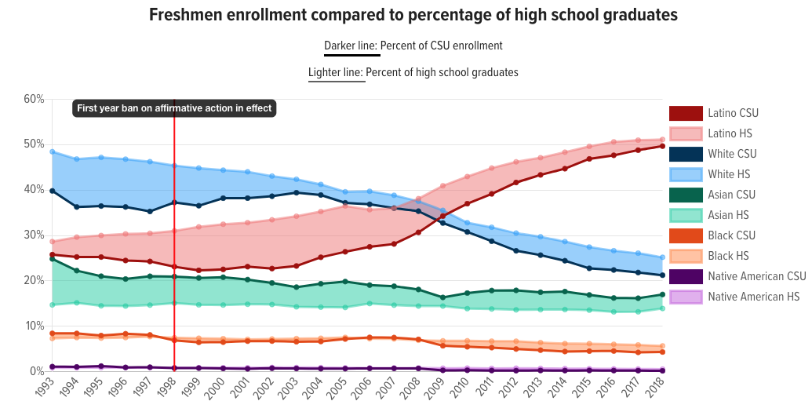
Overrepresentation and Model Minority
EdSource
Notes:
https://edsource.org/wp-content/uploads/2020/10/freshmenCHart.png
Jacob

Slide 18


Economic Effects
Harder to get into college
Harder to get jobs & promotions
Overall limits professional opportunities
JustGreatLawyers
AcademyAdvocate
Notes:
https://theacademyadvocate.com/wp-content/uploads/2019/01/affirmativeactions-900x624.png
https://www.justgreatlawyers.com/images/2da94379a38e65fb92735751aa852c9a29ded8da.png

Slide 19
Potential Solutions
05

Slide 20
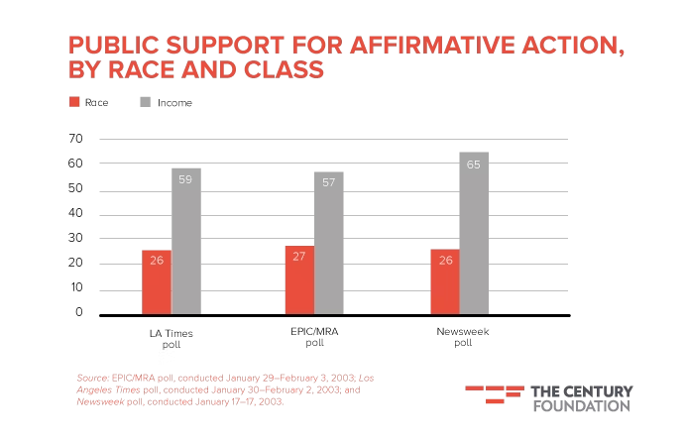
Economic Based Affirmative Action
1
More suitable to helping the least fortunate
More universal/acceptable idea to help the poor
Statistically more effective in reducing poverty
Does not solve racial discrimination in admissions

Slide 21
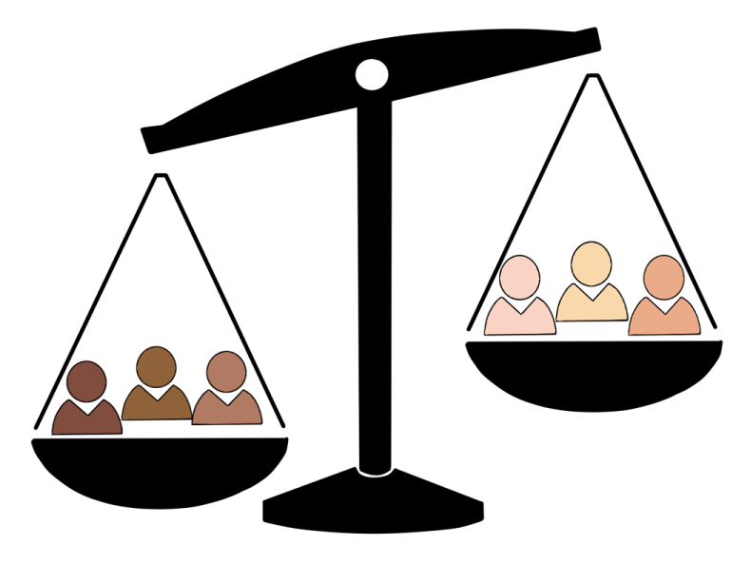

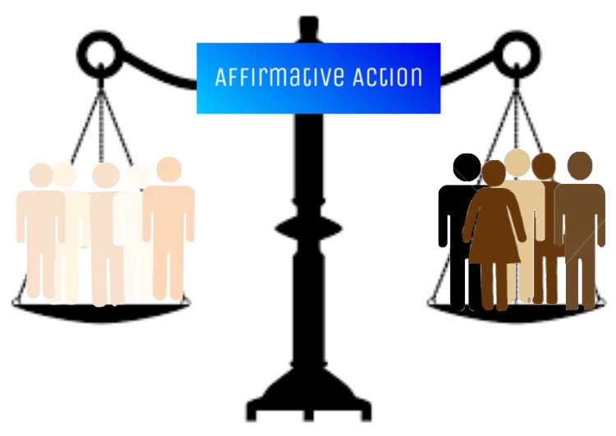
Eliminating Affirmative Action Completely
2
PVPHSNews
Miami High News
Notes:
Jacob
https://miamihighnews.com/wp-content/uploads/2021/02/option-1.jpeg
http://www.pvphsnews.com/wp-content/uploads/2014/03/infographic.png

Slide 22

Implications and Limitations
Would make it harder for underrepresented minority groups
Decrease diversity in colleges and businesses
Chief Learning Officer
Notes:
https://www.chieflearningofficer.com/wp-content/uploads/2019/12/DI.jpg

Slide 23
Final
Solution
06

Slide 24
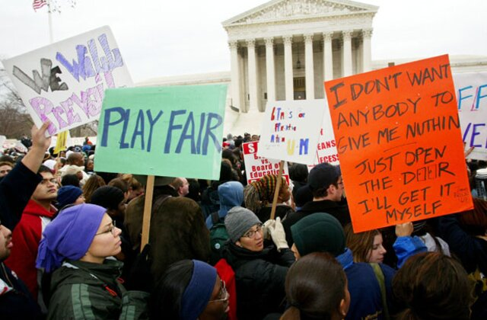
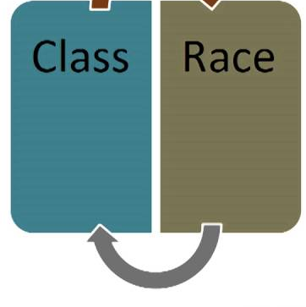

Final Solution
Elimination of race-based affirmative action system
Creation of class-based affirmative action system
Implementation of a merit-based support program

Slide 25


Conclusion

Slide 26
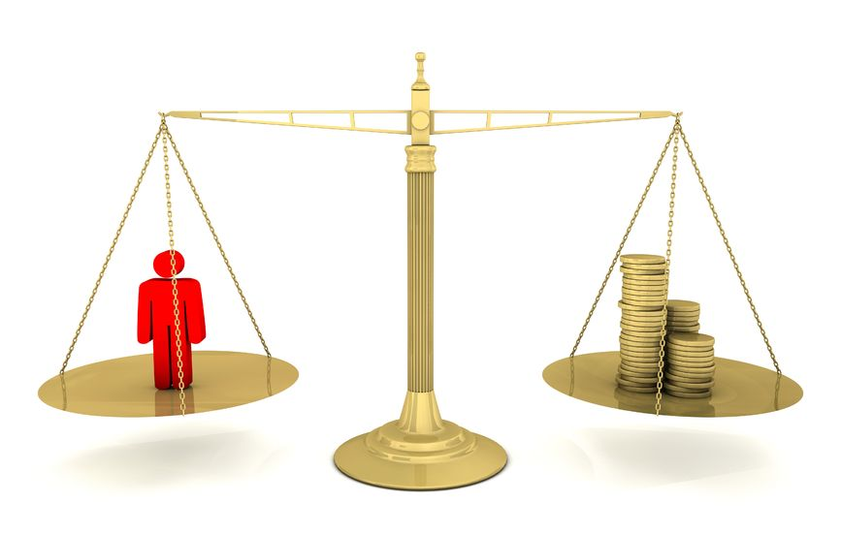
Call to Action
Class-based affirmative action
Merit-based affirmative action
Fair and equitable opportunity to all
Execunet
Notes:
https://www.execunet.com/fair-equitable-compensation-foundation-hr-programs/

Slide 27
Works Cited
“Conflicted Views of Affirmative Action.” Pew Research Center, 14 May 2003, https://www.pewresearch.org/politics/2003/05/14/conflicted-views-of-affirmative-action/. Accessed 13 February 2023.
Gómez, Vianney. “As courts weigh affirmative action, how Americans view college admissions factors.” Pew Research Center, 26 April 2022, https://www.pewresearch.org/fact-tank/2022/04/26/u-s-public-continues-to-view-grades-test-scores-as-top-factors-in-college-admissions/. Accessed 13 February 2023.
McGee, Vanesha. “How Will the End of Affirmative Action Impact Black and Latino/a Students?” BestColleges, 17 August 2022, https://www.bestcolleges.com/blog/how-will-the-end-of-affirmative-action-impact-black-and-latino-students/. Accessed 26 January 2023.
Bleemer, Zachary. “Publications | Center for Studies in Higher Education.” Cshe.berkeley.edu, Aug. 2020, cshe.berkeley.edu/publications/affirmative-action-mismatch-and-economic-mobility-after-california%E2%80%99s-proposition-209.
Chin, Margaret. “Asian Americans, Bamboo Ceilings, and Affirmative Action.” Contexts, vol. 15, no. 1, 2016, pp. 70–73, www.jstor.org/stable/pdf/26370351.pdf?refreqid=excelsior%3Afe8957a3d11ec82b88d6209bb3016f12&ab_segments=0%2FSYC-6744_basic_search%2Fcontrol&origin=. Accessed 27 Jan. 2023.

Slide 28
Works Cited (contd)
Dearing, Eric & Toma, E. (2007). “The Effects of Affirmative Action on Employment Outcomes of African Americans and Asian Americans.” Journal of Human Resources, 42(1), pp. 121-144.
Hyun-Joo, Jane, et al. "The Model Minority Stereotype: An Examination of Asian Americans and Education." Journal of Educational Issues of Language Minority Students, vol. 29, 2010, pp. 53-68.
Merriam-Webster. “Merriam-Webster Dictionary.” Merriam-Webster.com, Merriam-Webster, 2022, www.merriam-webster.com/.
Thomas, R. Roosevelt. “Affirmative Action: From the Perspective of Diversity.” Phylon (1960-),
vol. 49, no. 3/4, 2001, pp. 99–136. JSTOR, https://doi.org/10.2307/3132624. Accessed 27 Jan. 2023.
Schuck, Peter H. “Affirmative Action: Past, Present, and Future.” Yale Law & Policy Review,
vol. 20, no. 1, 2002, pp. 1–96. JSTOR, http://www.jstor.org/stable/41308517. Accessed 27 Jan. 2023.
Kang, Jay Caspian. “Where Does Affirmative Action Leave Asian-Americans?” The New York Times, 29 July 2021, https://www.nytimes.com/2019/08/28/magazine/where-does-affirmative-action-leave-asian-americans.html. Accessed 27 January 2023.

